Slide 1
Cross-Platform Web Design
Assignment 2: Group Project
Group Name: 404

Slide 2
About Us
Joyal Jojo - Team Leader
Charmi Boricha - Front End Designer
Sravan Suresh/Joyal jojo- Front End Developer
Valeria Kolesnikova - User Experience Developer
Collaboration Methods: GitHub, Discord, WhatsApp Group Chat, after class meetings

Slide 3

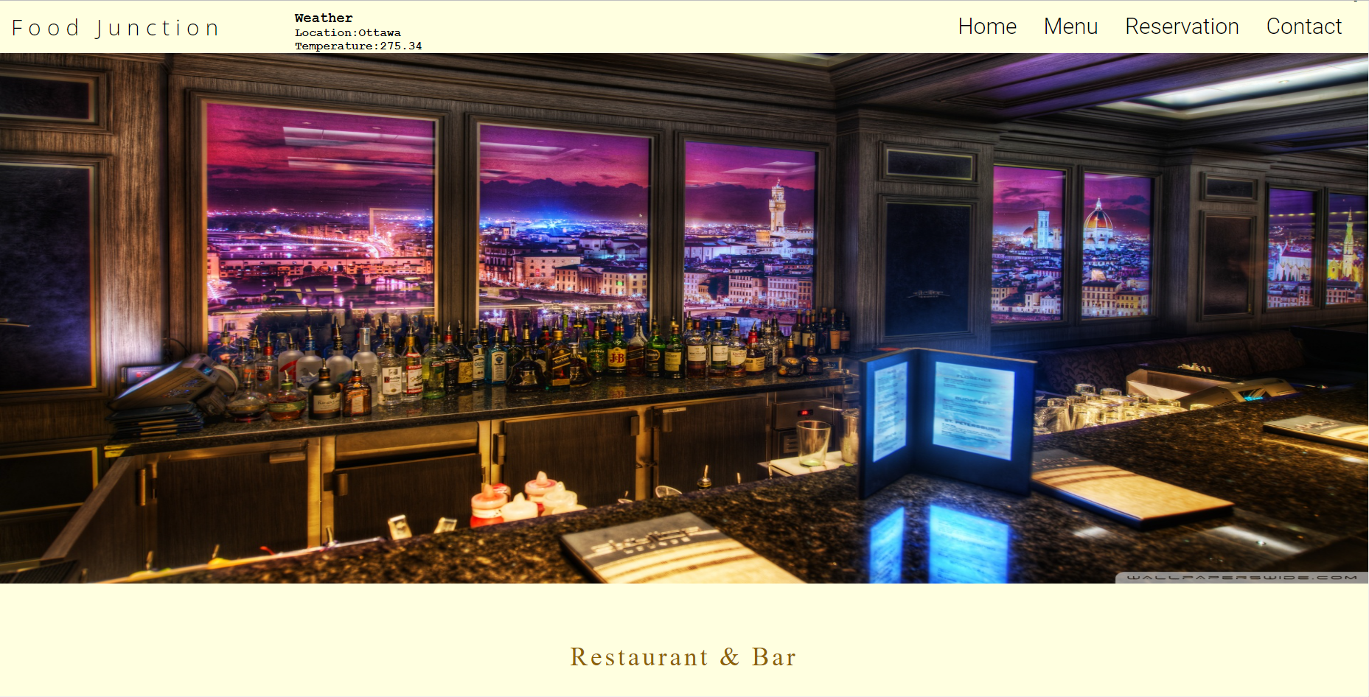
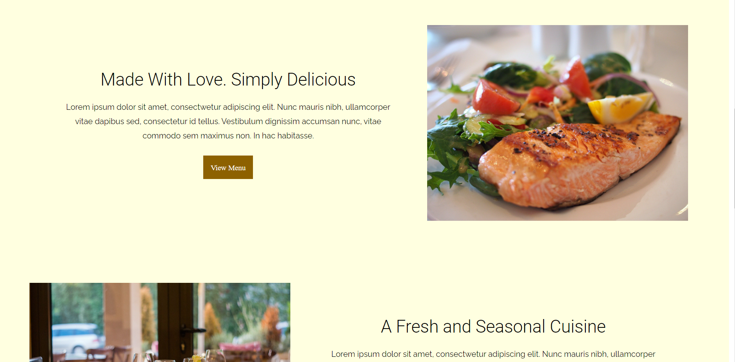
Project:
Organization Name: Restaurant & Bar “Food Junction”
Purpose of Website: To attract customers and to help to choose you over other eateries
Theme: Soft beige color with many colorful pictures
Font Style/Color: ROBOTO, Raleway, Open Sans in black and greenish brown colors(headers)

Slide 4
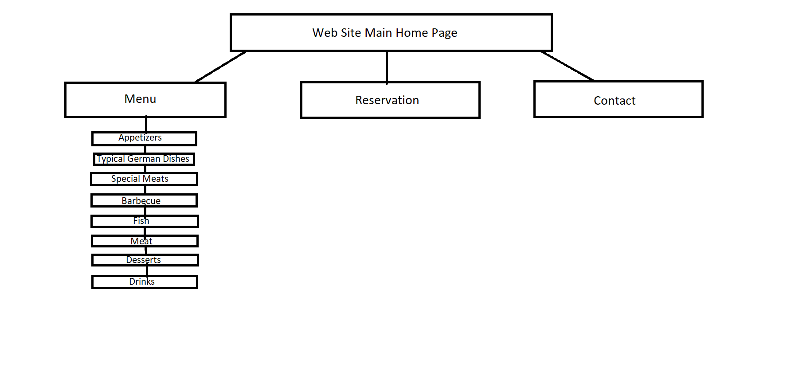
The Website contains 4 major pages
The main Home page Menu page:
Contains 8 subpages with menu varieties
Reservation page
Contact page
User experience
Physical Computing
HTML, CSS,JS

Slide 5
Page Layout

Slide 6
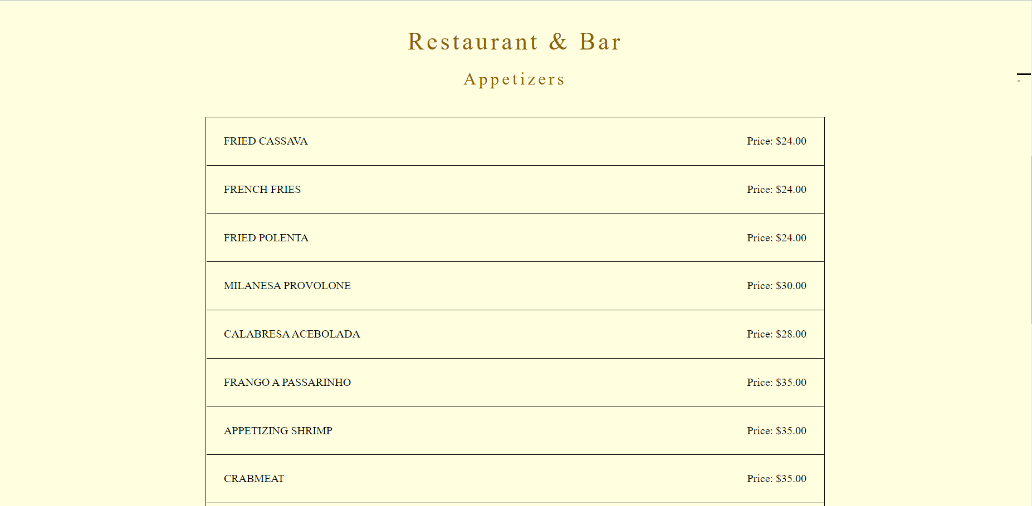
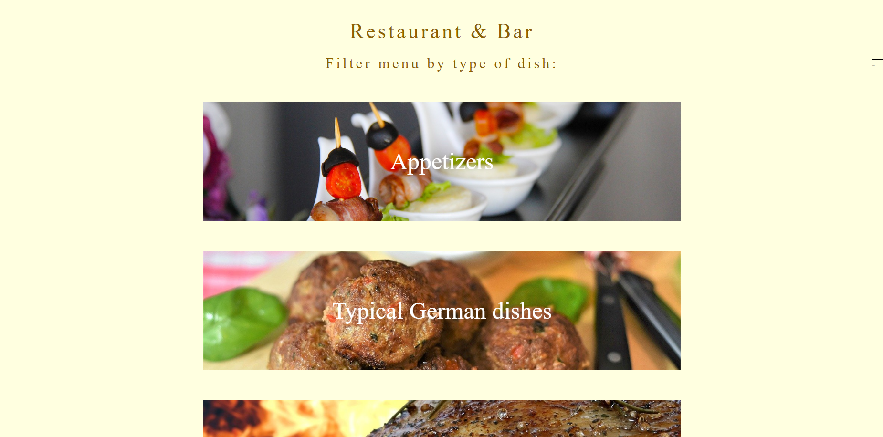
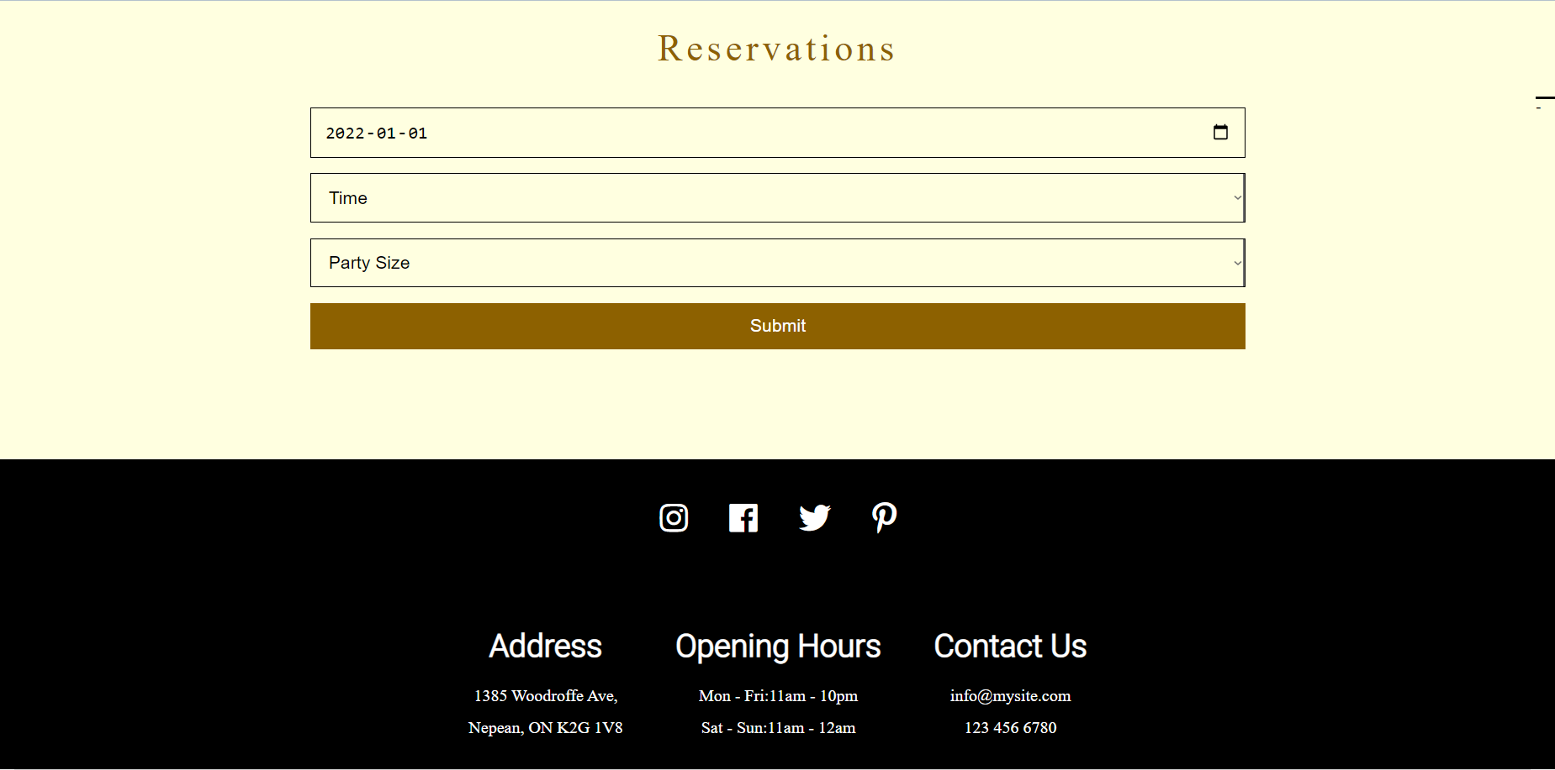

Slide 7
Color Palette

Slide 8
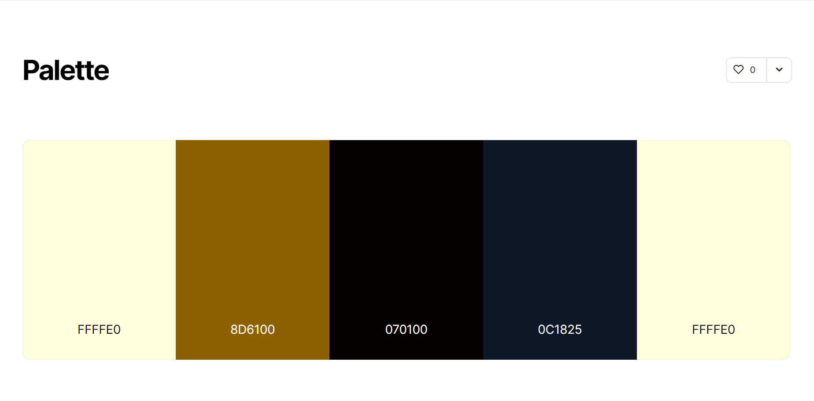

Slide 9
Code samples

Slide 10
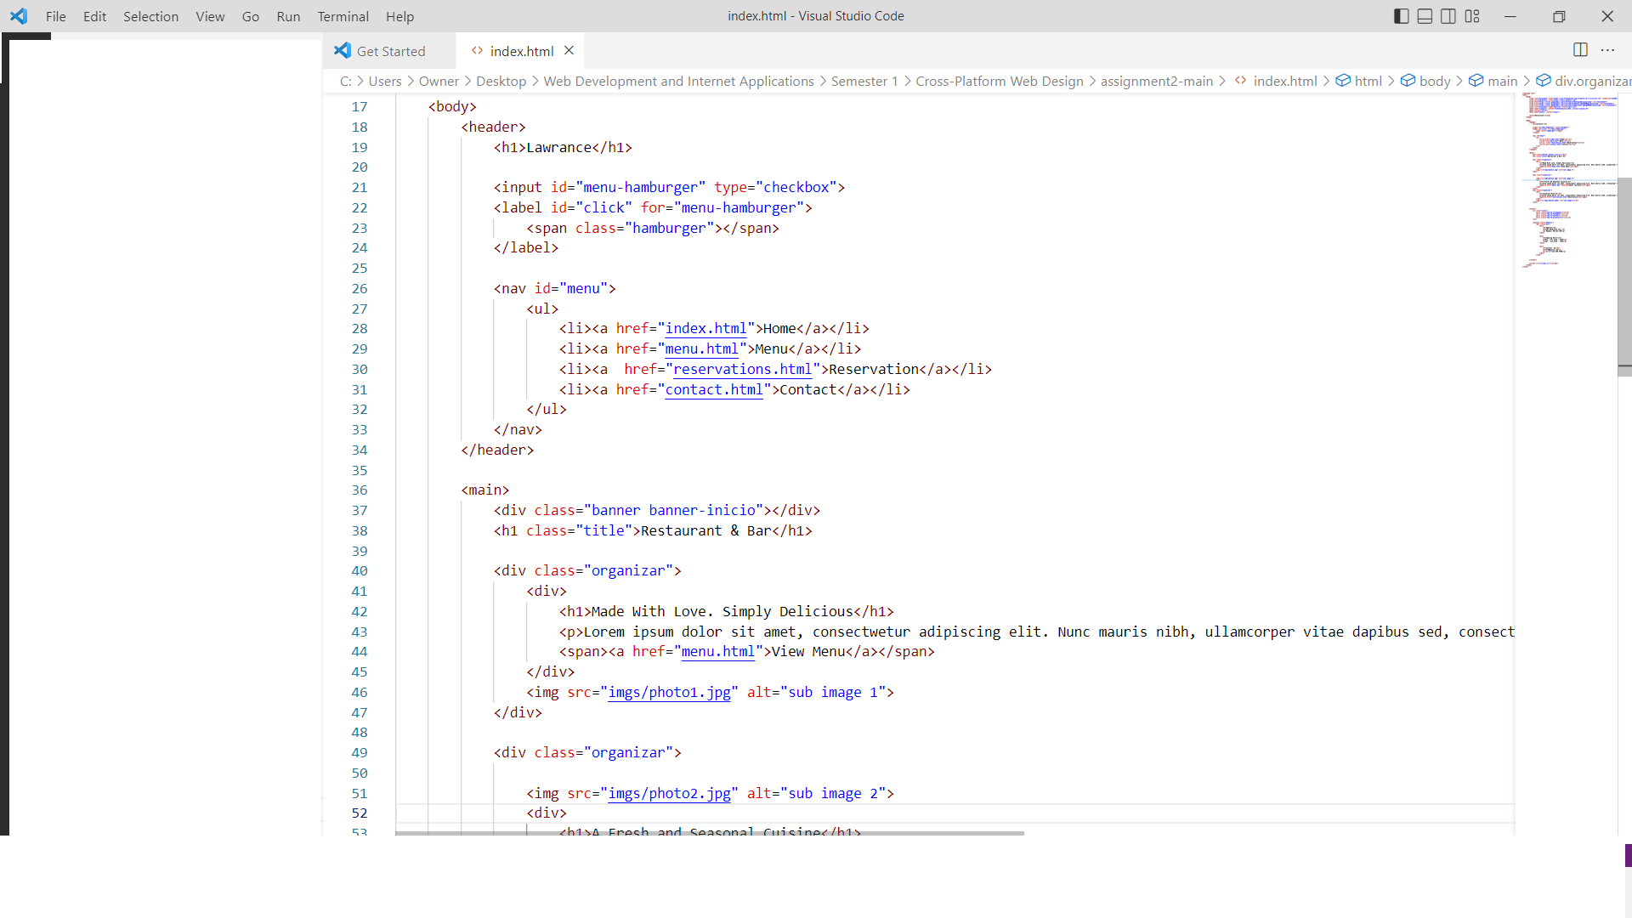
Index.html
Was used simple html code to create web pages

Slide 11
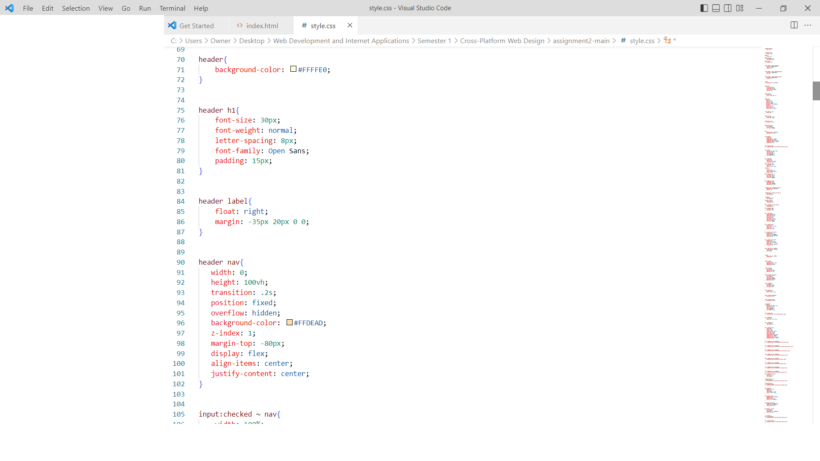
CSS

Slide 12
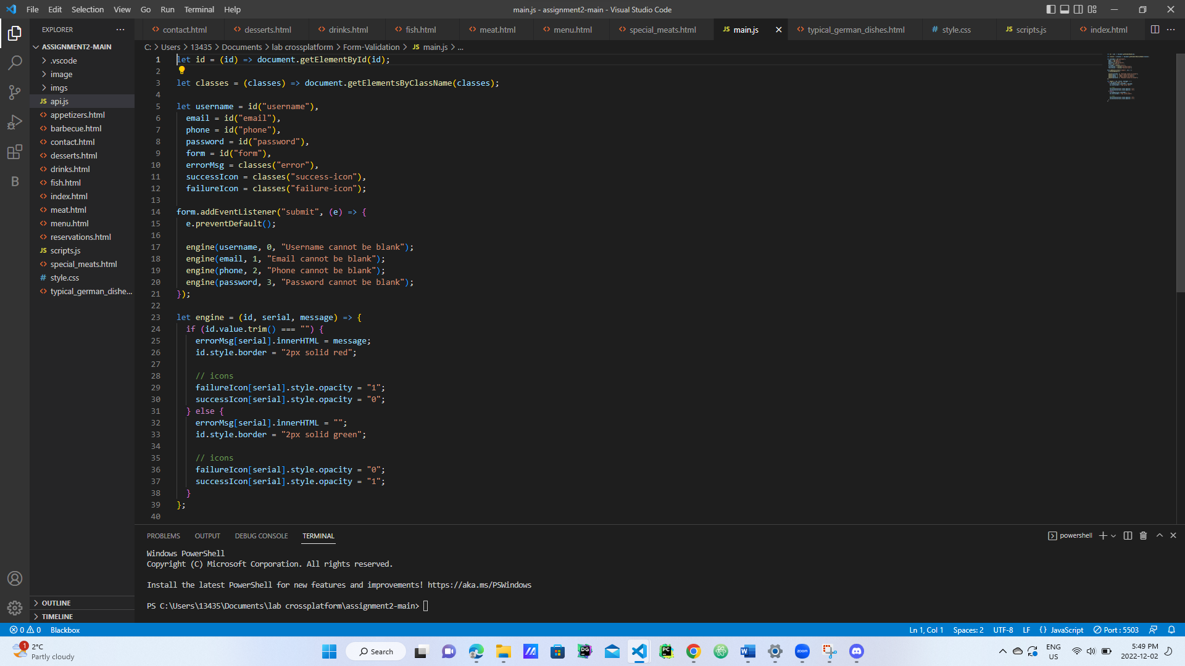
JS

Slide 13
API Integration

Slide 14
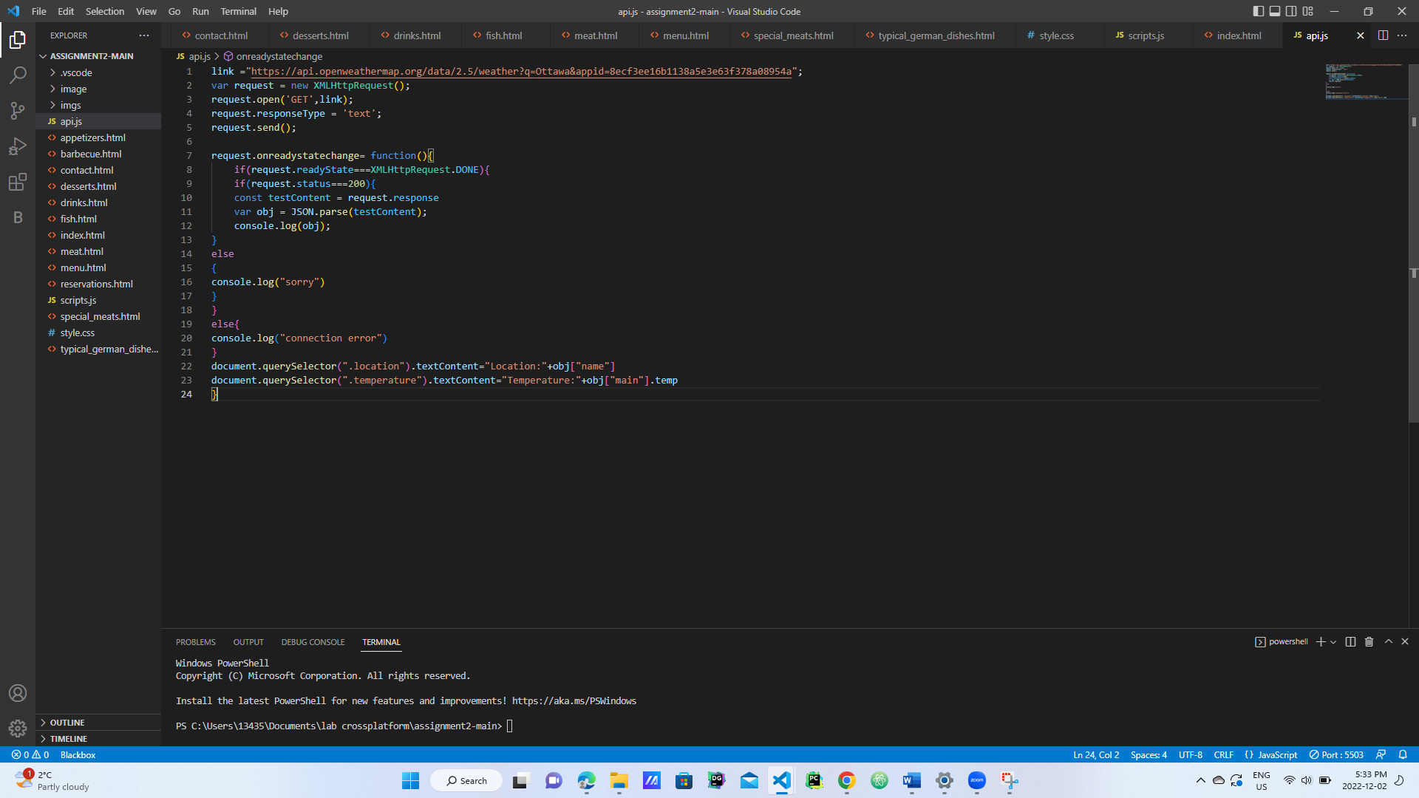

API from : Open Weather API
Shows the temperature and weather location of the Restaurant.

